Slide 1
Chapter 4
Solving for the Unknown
Math for Business and Finance: an Algebraic Approach, 3rd Edition Jeffrey Slater
© McGraw Hill LLC. All rights reserved. No reproduction or distribution without the prior written consent of McGraw Hill LLC.

Slide 2
Learning Unit Objectives
L U 4-1: Solving Equations for the Unknown.
Explain the basic procedures used to solve equations for the unknown.
List the five rules and the mechanical steps used to solve for the unknown in seven situations; know how to check the answers.
L U 4-2: Solving Word Problems for the Unknown.
List the steps for solving word problems.
Complete blueprint aids to solve word problems; check the solutions.
L U 4-3: Ratios and Proportions.
Understand ratios and proportions and solve for the unknown.

Slide 3
Basic Equation-Solving Procedure Terminology
Expression – A meaningful combination of numbers and letters called terms.
Equation – A mathematical statement with an equal sign showing that a mathematical expression on the left equals the mathematical expression on the right.
Formula – An equation that expresses in symbols a general fact, rule, or principle.
Variables – Equations use letters as symbols that represent one or more numbers. These symbols, usually a letter of the alphabet , are a variable that stand for a number.
Constants – A fixed number such as a 3 or a -7.

Slide 4
Variables and Constants Rules
If no number is in front of a letter, it is a 1:
B = 1B; C = 1C
If no sign is in front of a letter or number, it is a positive:
C = +C; 4 = +4

Slide 5
Solving Equations
The meaning of the symbols +, −, × and ÷ has not changed, however, some variations occur.
You can write A times B as: A×B, A *B or A B.
Key thing to remember is that to solve an equation, you must find a number that can replace the unknown in the equation and make it a true statement.

Slide 6
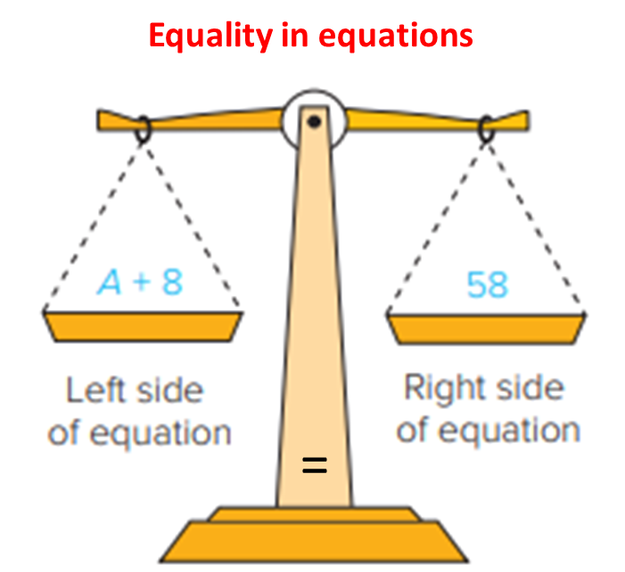
Solving Equations for the Unknown 1
Dick’s age in 8 years will equal 58.
The variable “A” represents Dick’s current age.
Access the text alternative for slide images

Slide 7
Solving Equations for the Unknown 2
Verbal statement | Variable A (age)
Dick’s age 8 years ago | A − 8
Dick’s age 8 years from today | A + 8
Four times Dick’s age | 4A
One-fifth Dick’s age | A/5

Slide 8
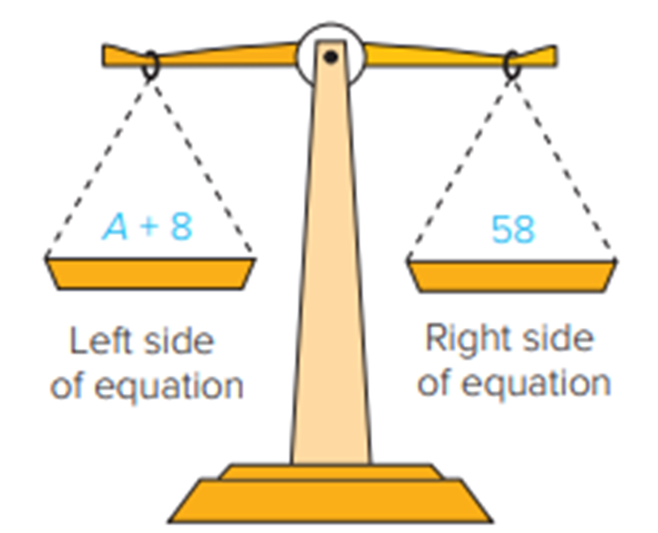
Solving for the Unknown Rule
Whatever you do to one side of an equation, you must do to the other side.
Perform operations of addition, subtraction, multiplication or division to both sides of the equation to keep the equation balanced.
Access the text alternative for slide images

Slide 9
Opposite Process Rule 1
If an equation indicates a process such as addition, subtraction, multiplication, or division, solve for the unknown or variable by using the opposite process.
For example:
If the equation process is addition, solve for the unknown using subtraction.
If + then −
If − than +
If × then ÷
If ÷ then ×

Slide 10
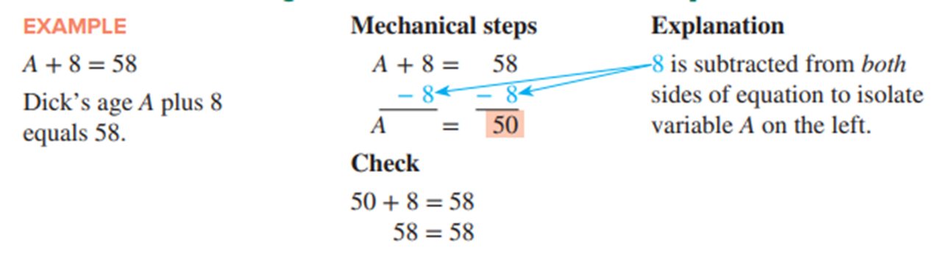
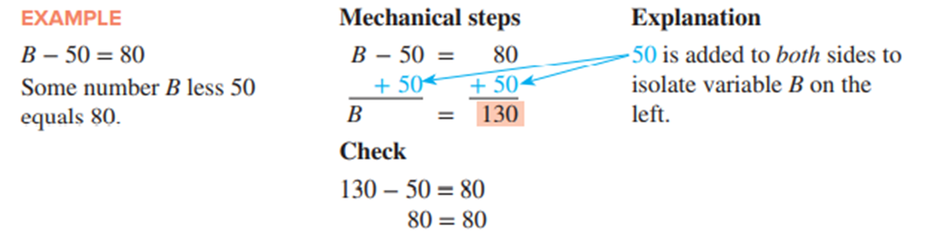
Opposite Process Rule 2
Access the text alternative for slide images

Slide 11
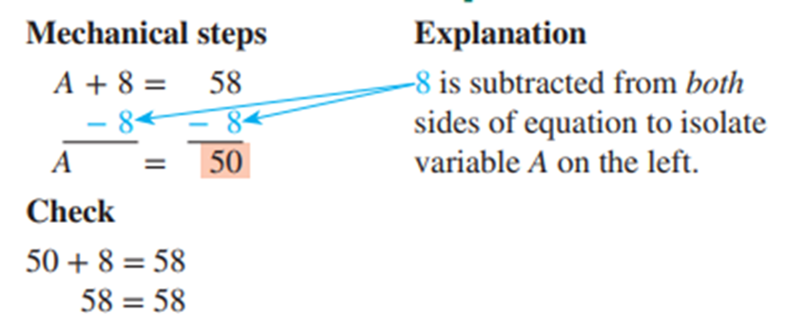
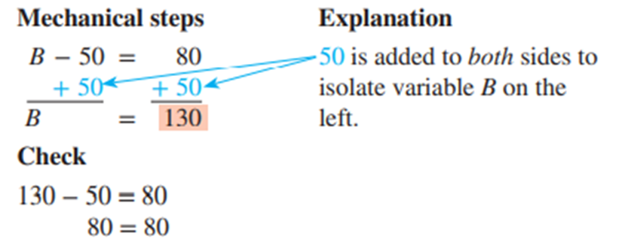
Opposite Process Rule 3
Example
A + 8 = 58
Dick’s age A plus 8 equals 58.
Example
Some number B less 50 equals 80.
Access the text alternative for slide images

Slide 12
Equation Equality Rule 1
You can add or subtract, multiply or divide (except zero) the same quantity or number to both sides of the equation without affecting the equality of the equation.
For example:
If the equation process is multiplication, solve for the unknown using division.
Dividing both sides by 7 does not change the equality of the equation.

Slide 13
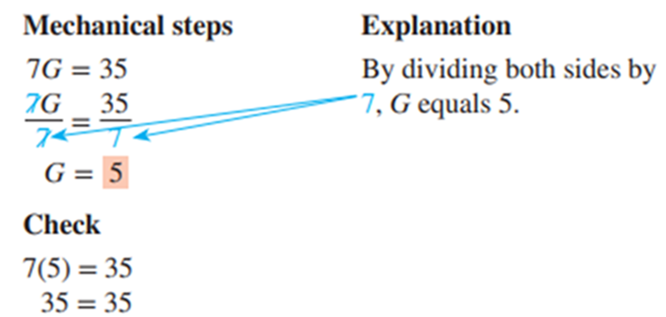
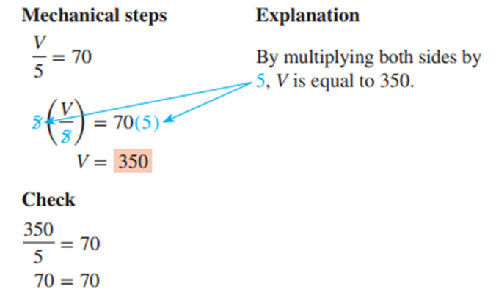
Equation Equality Rule 2
Example
7G = 35
Some number G times 7 equals 35.
Example
Some number V divided by 5 equals 70.
Access the text alternative for slide images

Slide 14
Multiple Processes Rule 1
When solving for an unknown that involves more than one process, do the addition and subtraction before the multiplication and division.

Slide 15
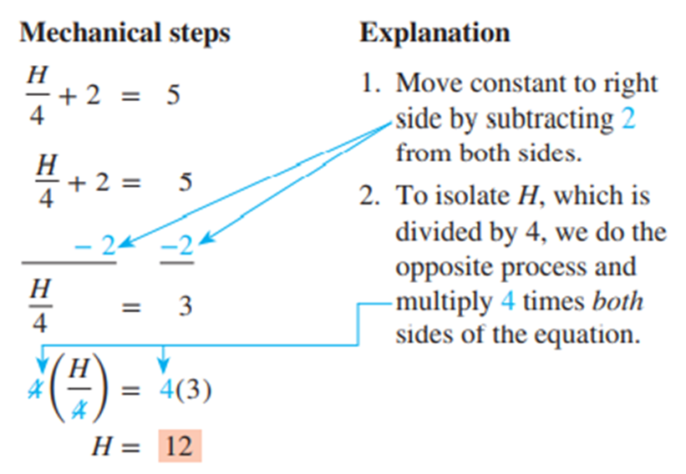
Multiple Processes Rule 2
Example
When we divide unknown H by 4 and add the result to 2. the answer is 5.
Check
3 + 2 = 5
5 = 5
Access the text alternative for slide images

Slide 16
Distributive Rule 1
When equations contain parentheses (which indicates grouping together):
Solve for the unknown by multiplying each item inside the parentheses by the number or letter just outside the parentheses. This is known as the distributive rule.
Then continue to solve for the unknown with the opposite process used in the equation. Do the addition and subtraction first; then do the multiplication and division.

Slide 17
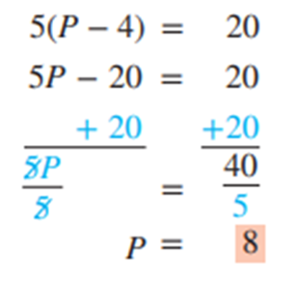
Distributive Rule 2
Example
Mechanical steps
Explanation
Parentheses tell us that everything inside parentheses is multiplied by 5. Multiply 5 by P and 5 by −4.
Add 20 to both sides to isolate 5P on left.
To remove 5 in from of P, divide both sides by 5 to result in P equals 8.
The unknown P less 4. multiplied by 5 equals 20.
Check
Access the text alternative for slide images

Slide 18
Like Unknowns Rule
To solve equations with like unknowns:
Combine the unknowns.
Then solve with the opposite process used in the equation.
Example
4A + A = 20
Mechanical steps
4A + A = 20
Explanation
To solve this equation: 4A + 1A = 5A.Thus.5A = 20. To solve for A, divide both sides by 5, leaving A equals 4.
Check

Slide 19
Solving Word Problems for the Unknown 1
5 Steps
Carefully read the entire problem. You may have to read it several times.
Ask yourself: “What is the problem looking for?”
When you are sure what the problem is asking, let a variable represent the unknown. If the problem has more than one unknown, represent the second unknown in terms of the same variable. For example, if the problem has two unknowns, Y is one unknown. Assuming the second unknown is 4 times the first unknown, it would be represented by 4Y.
Visualize the relationship between the unknowns and variables. Then set up an equation to solve for the unknown(s).
Check your results to ensure accuracy.

Slide 20
Solving Word Problems for the Unknown 2
Blueprint aid
Helps organize unknown and given information and develop equation to solve word problems.
Unknown(s) | Variable(s) | Relationship

Slide 21
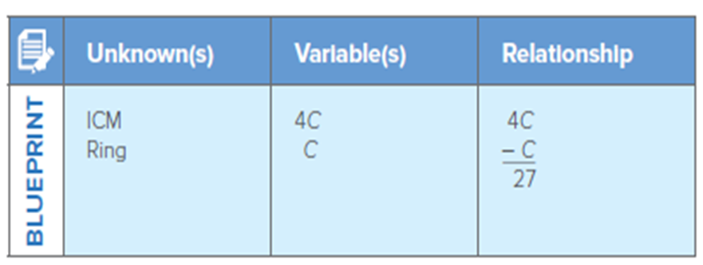
Solving Word Problems for the Unknowns 3
Example:
I C M Company sold 4 times as many computers as Ring Company. The difference in their sales is 27. How many computers of each company were sold?
Solution:
Mechanical steps
C = 9
Ring = 9 computers
I C M = 4(9)
= 36 computers
Access the text alternative for slide images

Slide 22
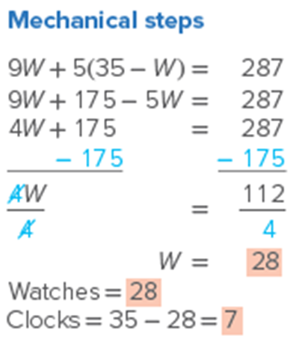
Solving Word Problems for the Unknowns 4
Example:
Andy sold watches for $9 and alarm clocks for $5 at a flea market. Total sales for 35 watches and alarm clocks were $287. How many of each did Andy sell? What were the total dollar sales of each?
Solution:
Access the text alternative for slide images

Slide 23
Textbook Problem 4-2
Problem Statement:
Solve for the unknown from the following equation: L U 4-1(2)
Solution:
A + 64 | = | 98
− 64 |  | − 64
A | = | 34
Check:

Slide 24
Textbook Problem 4-5
Problem Statement:
Solve for the unknown from the following equation: L U 4-1(2)
Solution:
Check:

Slide 25
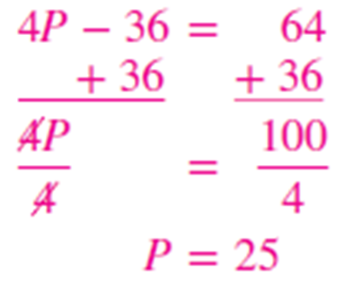
Textbook Problem 4-9
Problem Statement:
Solve for the unknown from the following equation: L U 4-1(2)
Solution:
Check:

Slide 26
Textbook Problem 4-15
Problem Statement:
Jessica and Josh are selling Entertainment Books to raise money for the art room at their school. One book sells for $15. Jessica received the prize for selling the most books in the school. Jessica sold 15 times more books than Josh. Together they sold 256 books. How many did each one of them sell?: L U 4-2(1)
Solution:

Slide 27
End of Main Content
© McGraw Hill LLC. All rights reserved. No reproduction or distribution without the prior written consent of McGraw Hill LLC.

Slide 28
Accessibility Content: Text Alternatives for Images
28

Slide 29
Solving Equations for the Unknown 1 – Text Alternative
Return to parent-slide containing images.
A weighing scale demonstrating equality in equations. In the weighing scale, the left pan represents the left side of an equation, and the right pan represents the right side of the equation. On the left side, we have A plus 8. On the right side, we have 58.
Return to parent-slide containing images.

Slide 30
Solving for the Unknown Rule – Text Alternative
Return to parent-slide containing images.
A weighing scale in which the left pan represents the left side of an equation, and the right pan represents the right side of the equation. On the left side, we have A plus 8. On the right side, we have 58.
Return to parent-slide containing images.

Slide 31
Opposite Process Rule 2 – Text Alternative
Return to parent-slide containing images.
For the first image: Example. A plus 8 equals 58. Dick's age A plus 8 equals 58. Mechanical steps. A plus 8 equals 58. Subtracting 8 from both sides of the equation gives A equals 50. Explanation. 8 is subtracted from both sides of equation to isolate variable A on the left. Check. 50 plus 8 equals 58. 58 equals 58.
For the second image: Example. B minus 50 equals 80. Some number B less 50 equals 80. Mechanical steps. B minus 50 equals 80. Adding 50 to both sides of the equation gives B equals 130. Explanation. 50 is added to both sides to isolate variable B on the left. Check. 130 minus 50 equals 80. 80 equals 80.
Return to parent-slide containing images.

Slide 32
Opposite Process Rule 3 – Text Alternative
Return to parent-slide containing images.
For the first image: Mechanical steps. A plus 8 equals 58. Subtracting 8 from both sides of the equation gives A equals 50. Explanation. 8 is subtracted from both sides of equation to isolate variable A on the left. Check. 50 plus 8 equals 58. 58 equals 58.
For the second image: Mechanical steps. B minus 50 equals 80. Adding 50 to both sides of the equation gives B equals 130. Explanation. 50 is added to both sides to isolate variable B on the left. Check. 130 minus 50 equals 80. 80 equals 80.
Return to parent-slide containing images.

Slide 33
Equation Equality Rule 2 – Text Alternative
Return to parent-slide containing images.
For the first image: Mechanical steps. 7 G equals 35. Dividing both sides of the equation by 7 gives G equals 5. Explanation. By dividing both sides by 7, G equals 5. Check. 7 times 5 equals 35. 35 equals 35.
For the second image: Mechanical steps. V over 5 equals 70. Both sides of the equation are multiplied by 5. Explanation. By multiplying both sides by 5, v is equal to 350. Check. 350 divided by 5 equals 70. 70 equals 70.
Return to parent-slide containing images.

Slide 34
Multiple Processes Rule 2 – Text Alternative
Return to parent-slide containing images.
Mechanical steps. H over 4 plus 2 equals 5. H over 4 plus 2 equals 5. Subtracting 2 from both sides of the equation gives H over 4 equals 3. Multiplying by 4 on both sides of the equation gives H equals 12. Explanation. 1. Move constant to right by subtracting 2 from both sides. 2. To isolate H, which is divided by 4, we do the opposite process and multiply 4 times both sides of the equation.
Return to parent-slide containing images.

Slide 35
Distributive Rule 2 – Text Alternative
Return to parent-slide containing images.
5 times (P minus 4) equals 20. 5 P minus 20 equals 20. Adding 20 on both sides of the equation gives 5 P equals 40. Dividing both sides of the resulting equation by 5 gives P equals 8.
Return to parent-slide containing images.

Slide 36
Solving Word Problems for the Unknowns 3 – Text Alternative
Return to parent-slide containing images.
A table consists of 3 columns and 2 rows. The text that reads, the blueprint is on the left of the first column. The row entries are as follows. Row 1. Unknowns: I C M. Variables: 4 C. Relationship: 4 C. Row 2. Unknowns: Ring. Variables: C. Relationship: negative C over 27.
Return to parent-slide containing images.

Slide 37
Solving Word Problems for the Unknowns 4 – Text Alternative
Return to parent-slide containing images.
For the first image: A table consists of 3 columns and 2 rows. The text that reads, the blueprint is on the left of the first column. The row entries are as follows. Row 1. Unknowns: I C M. Variables: 4 C. Relationship: 4 C. Row 2. Unknowns: Ring. Variables: C. Relationship: negative C over 27.
For the first image: Mechanical steps. 9 W plus 5 times (35 minus W) equals 287. 9 W plus 175 minus 5 W equals 287. 4 W plus 175 equals 287. Subtracting 175 from both sides on the equation gives 4 W equals 112. Dividing 4 on both sides of the equation gives W equals 28. Watches equals 28. Clocks equals 35 minus 28 equals 7.
Return to parent-slide containing images.

